Slide 1
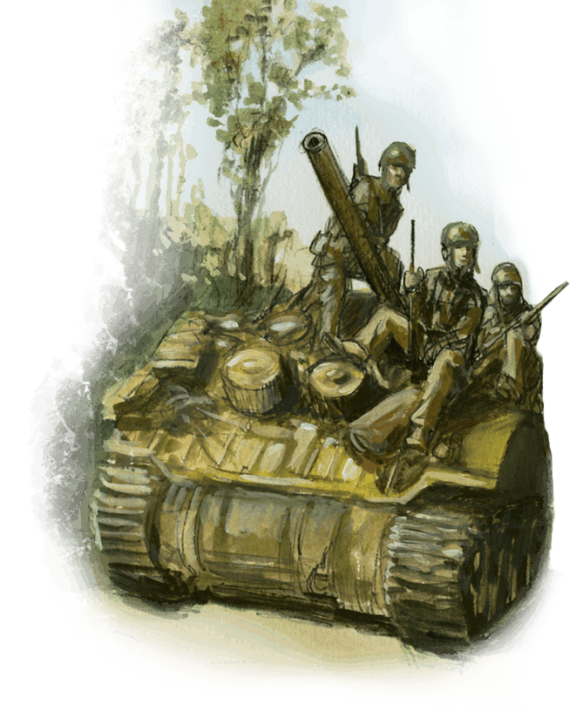
Welcome!

Slide 2
Talen, language, langue, sprache, lingua

Slide 3
Thanks
Translation:
Droopy007
Lucky91
Arnout
Junior72
DDB73
Quit2
Mrs. Quit2

Slide 4
Rules
- Score to referee
- Next round
- Position control / Controle de Position
- Jetons / Tokens

Slide 5
Scenario 1

Slide 6
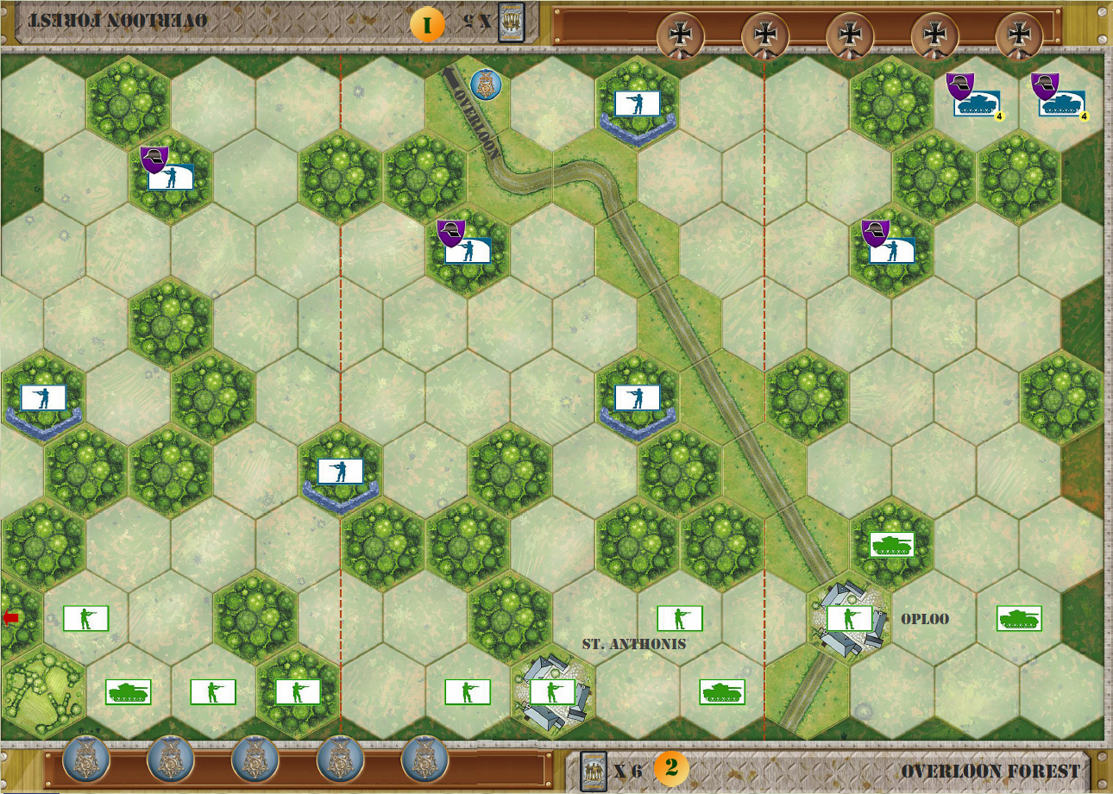
5 medals
Axis: 5 cards
Allies: 6 kaarten
Temp. Medal.
Special forces
Roads

Slide 7
Good Luck

Slide 8
Scenario 2

Slide 9
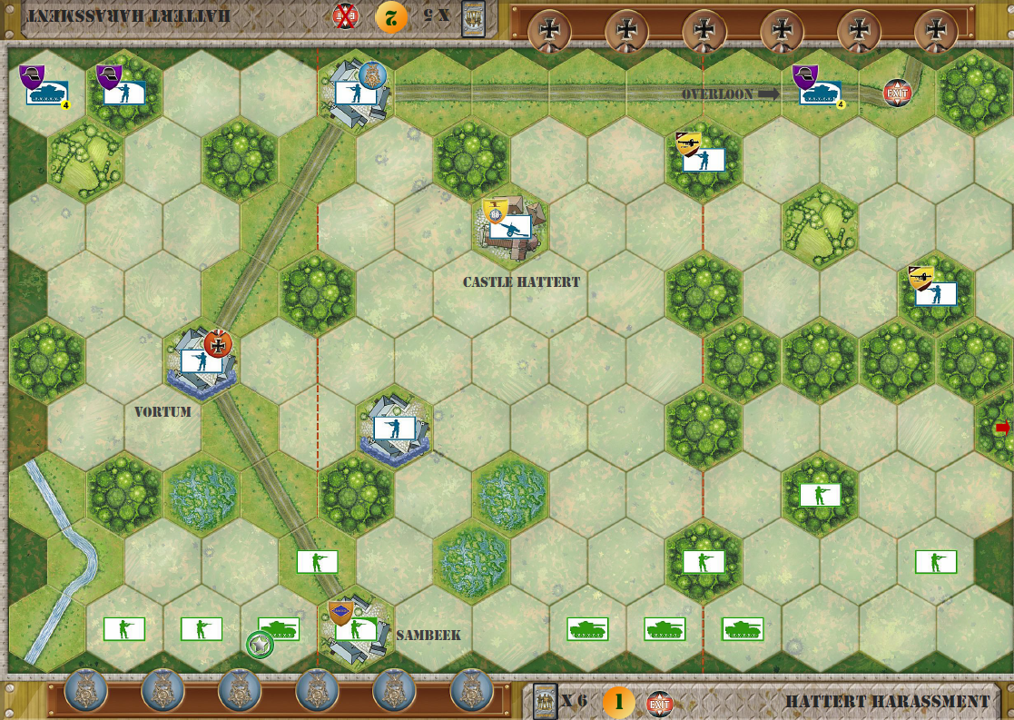
6 Medals
Axis: 5 cards
Allies: 6 cards
Temp. Medal.
Exit ( Allies )
Special Forces
SWA Anti-tank
Supported armor
88 mm
Marshes
Church

Slide 10
Buona Fortuna

Slide 11
Day 2

Slide 13
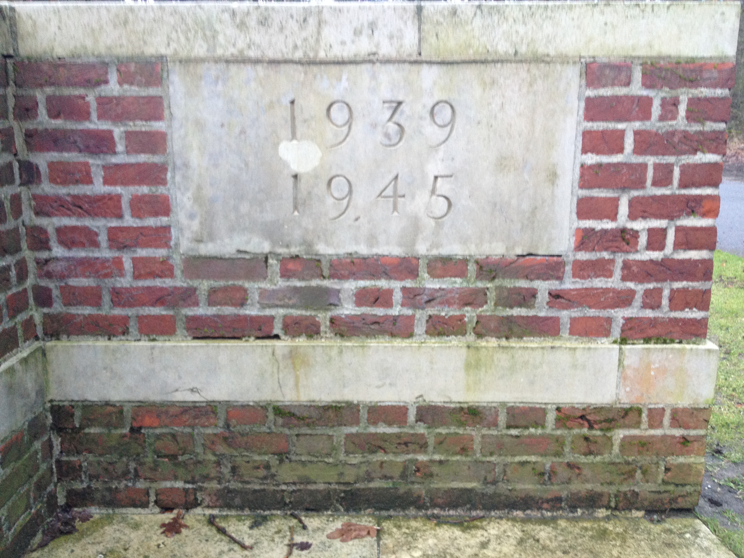

Slide 14
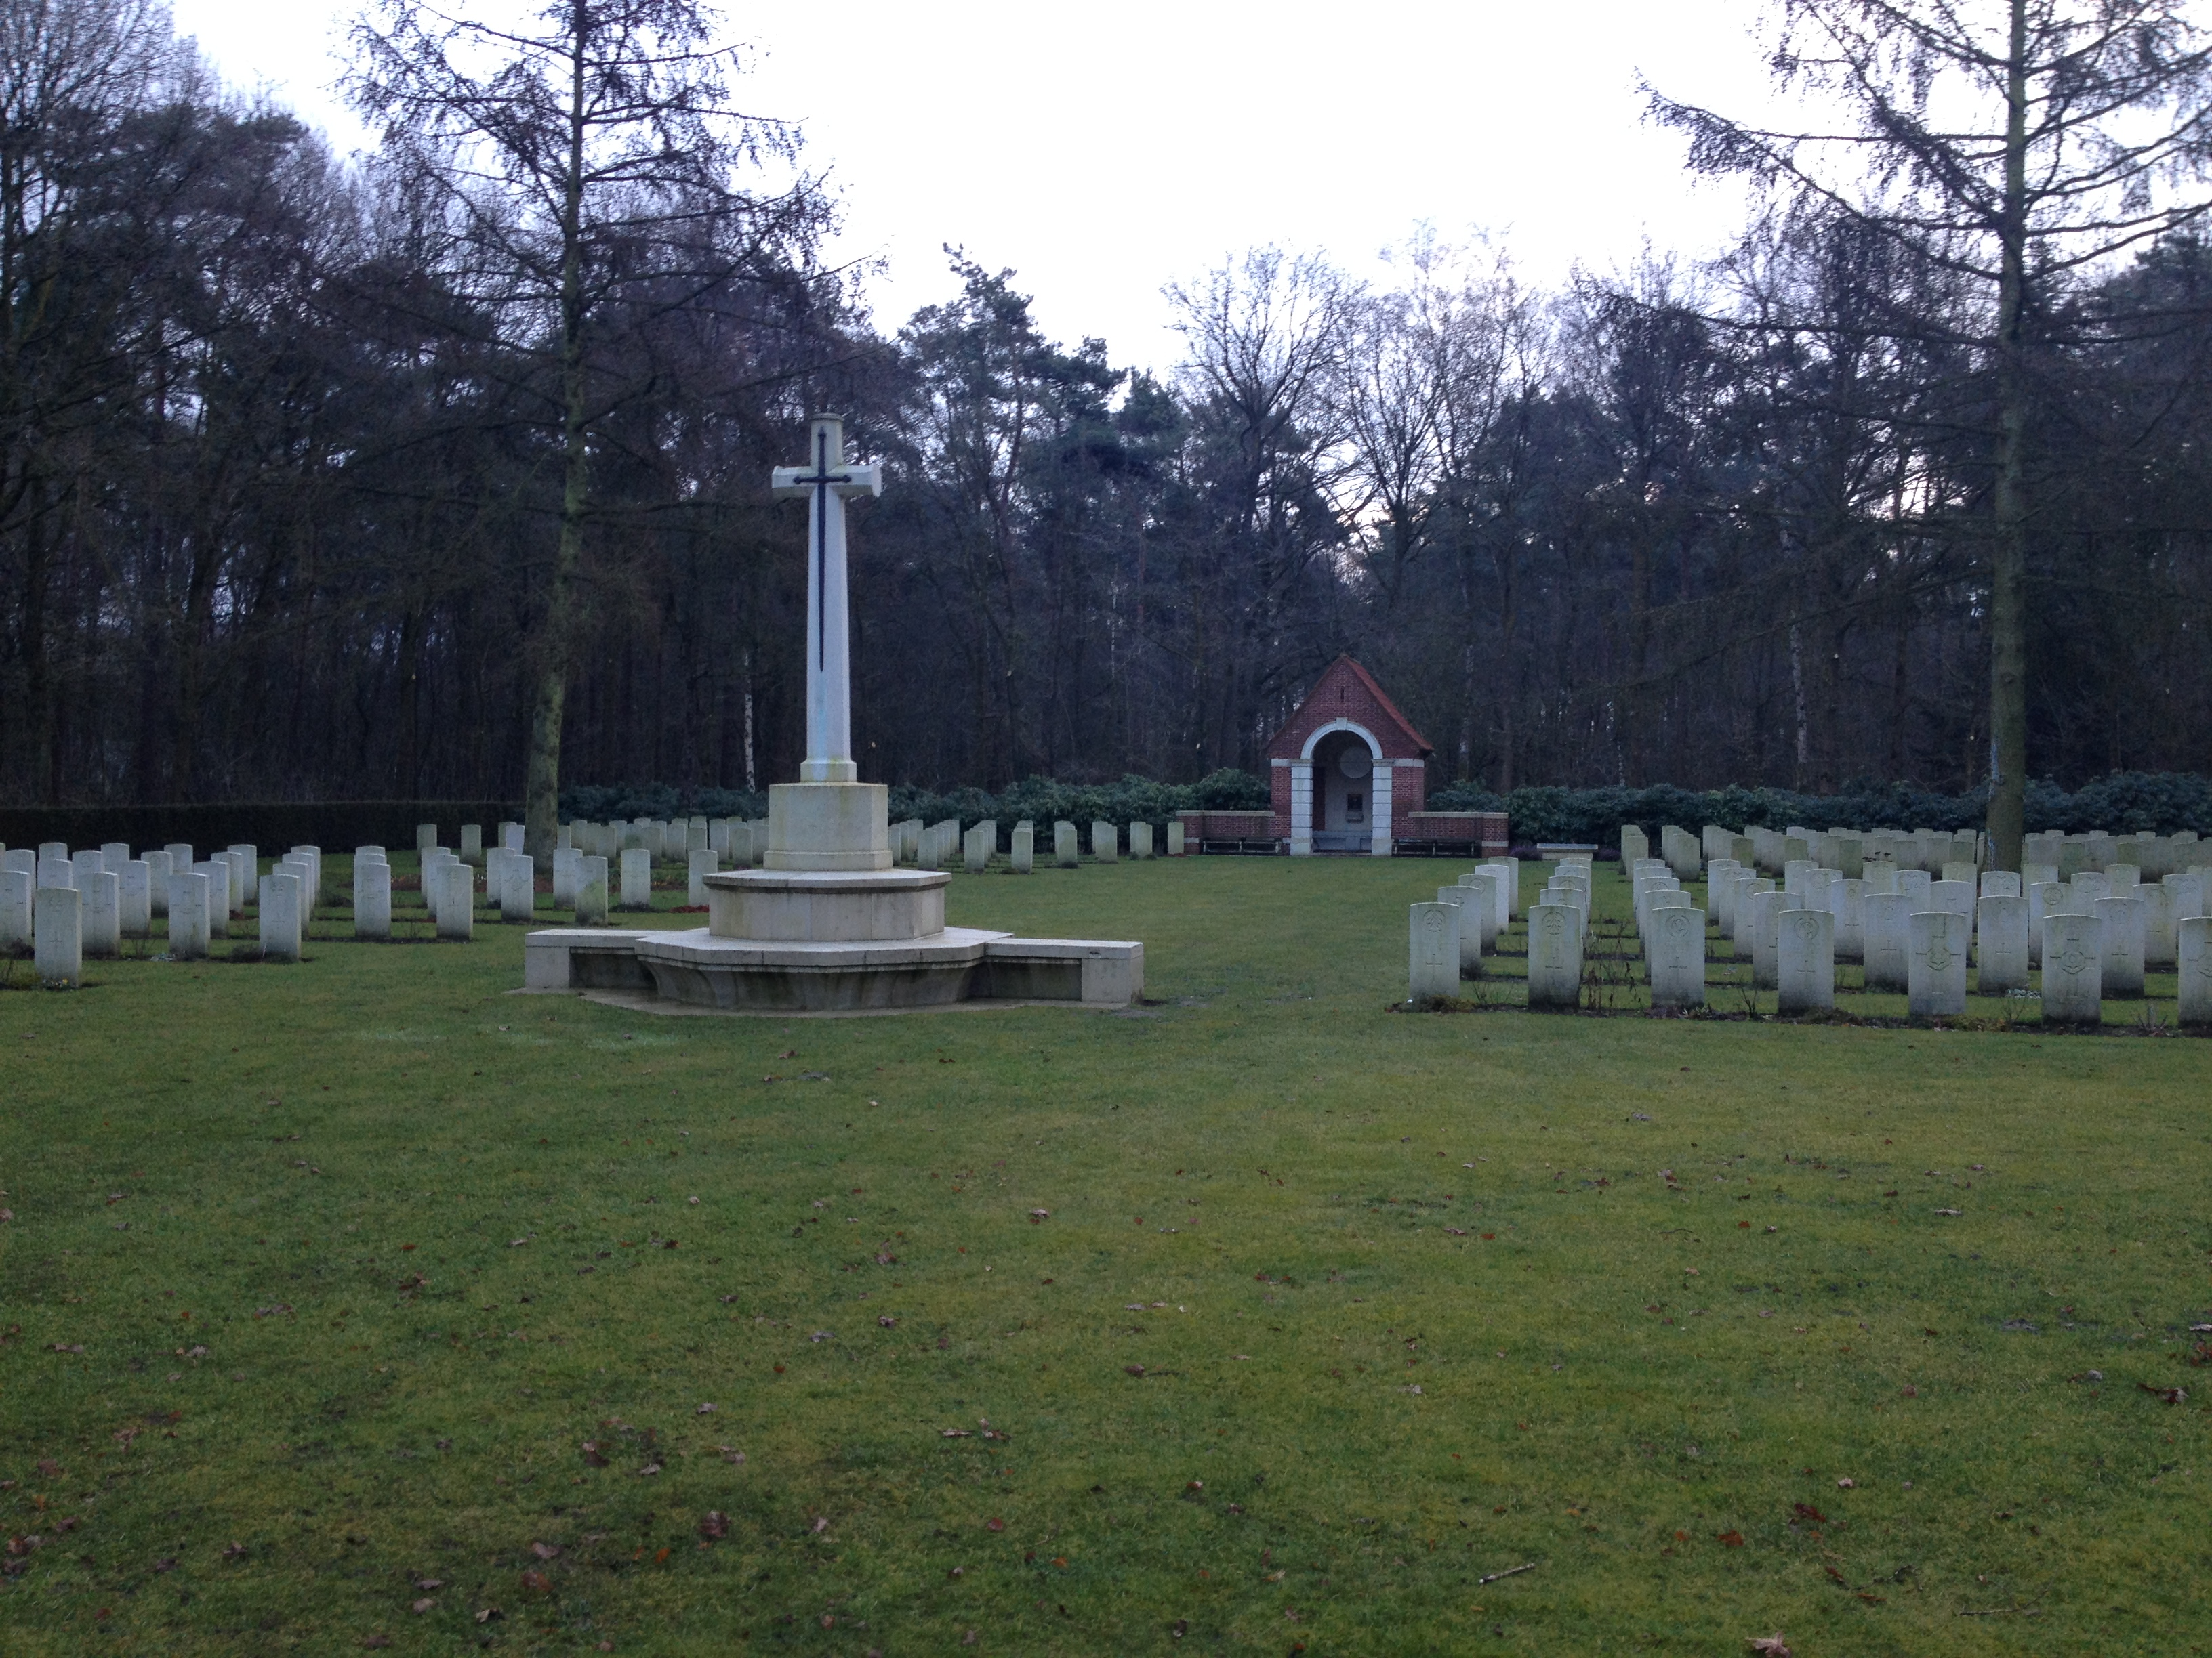

Slide 15
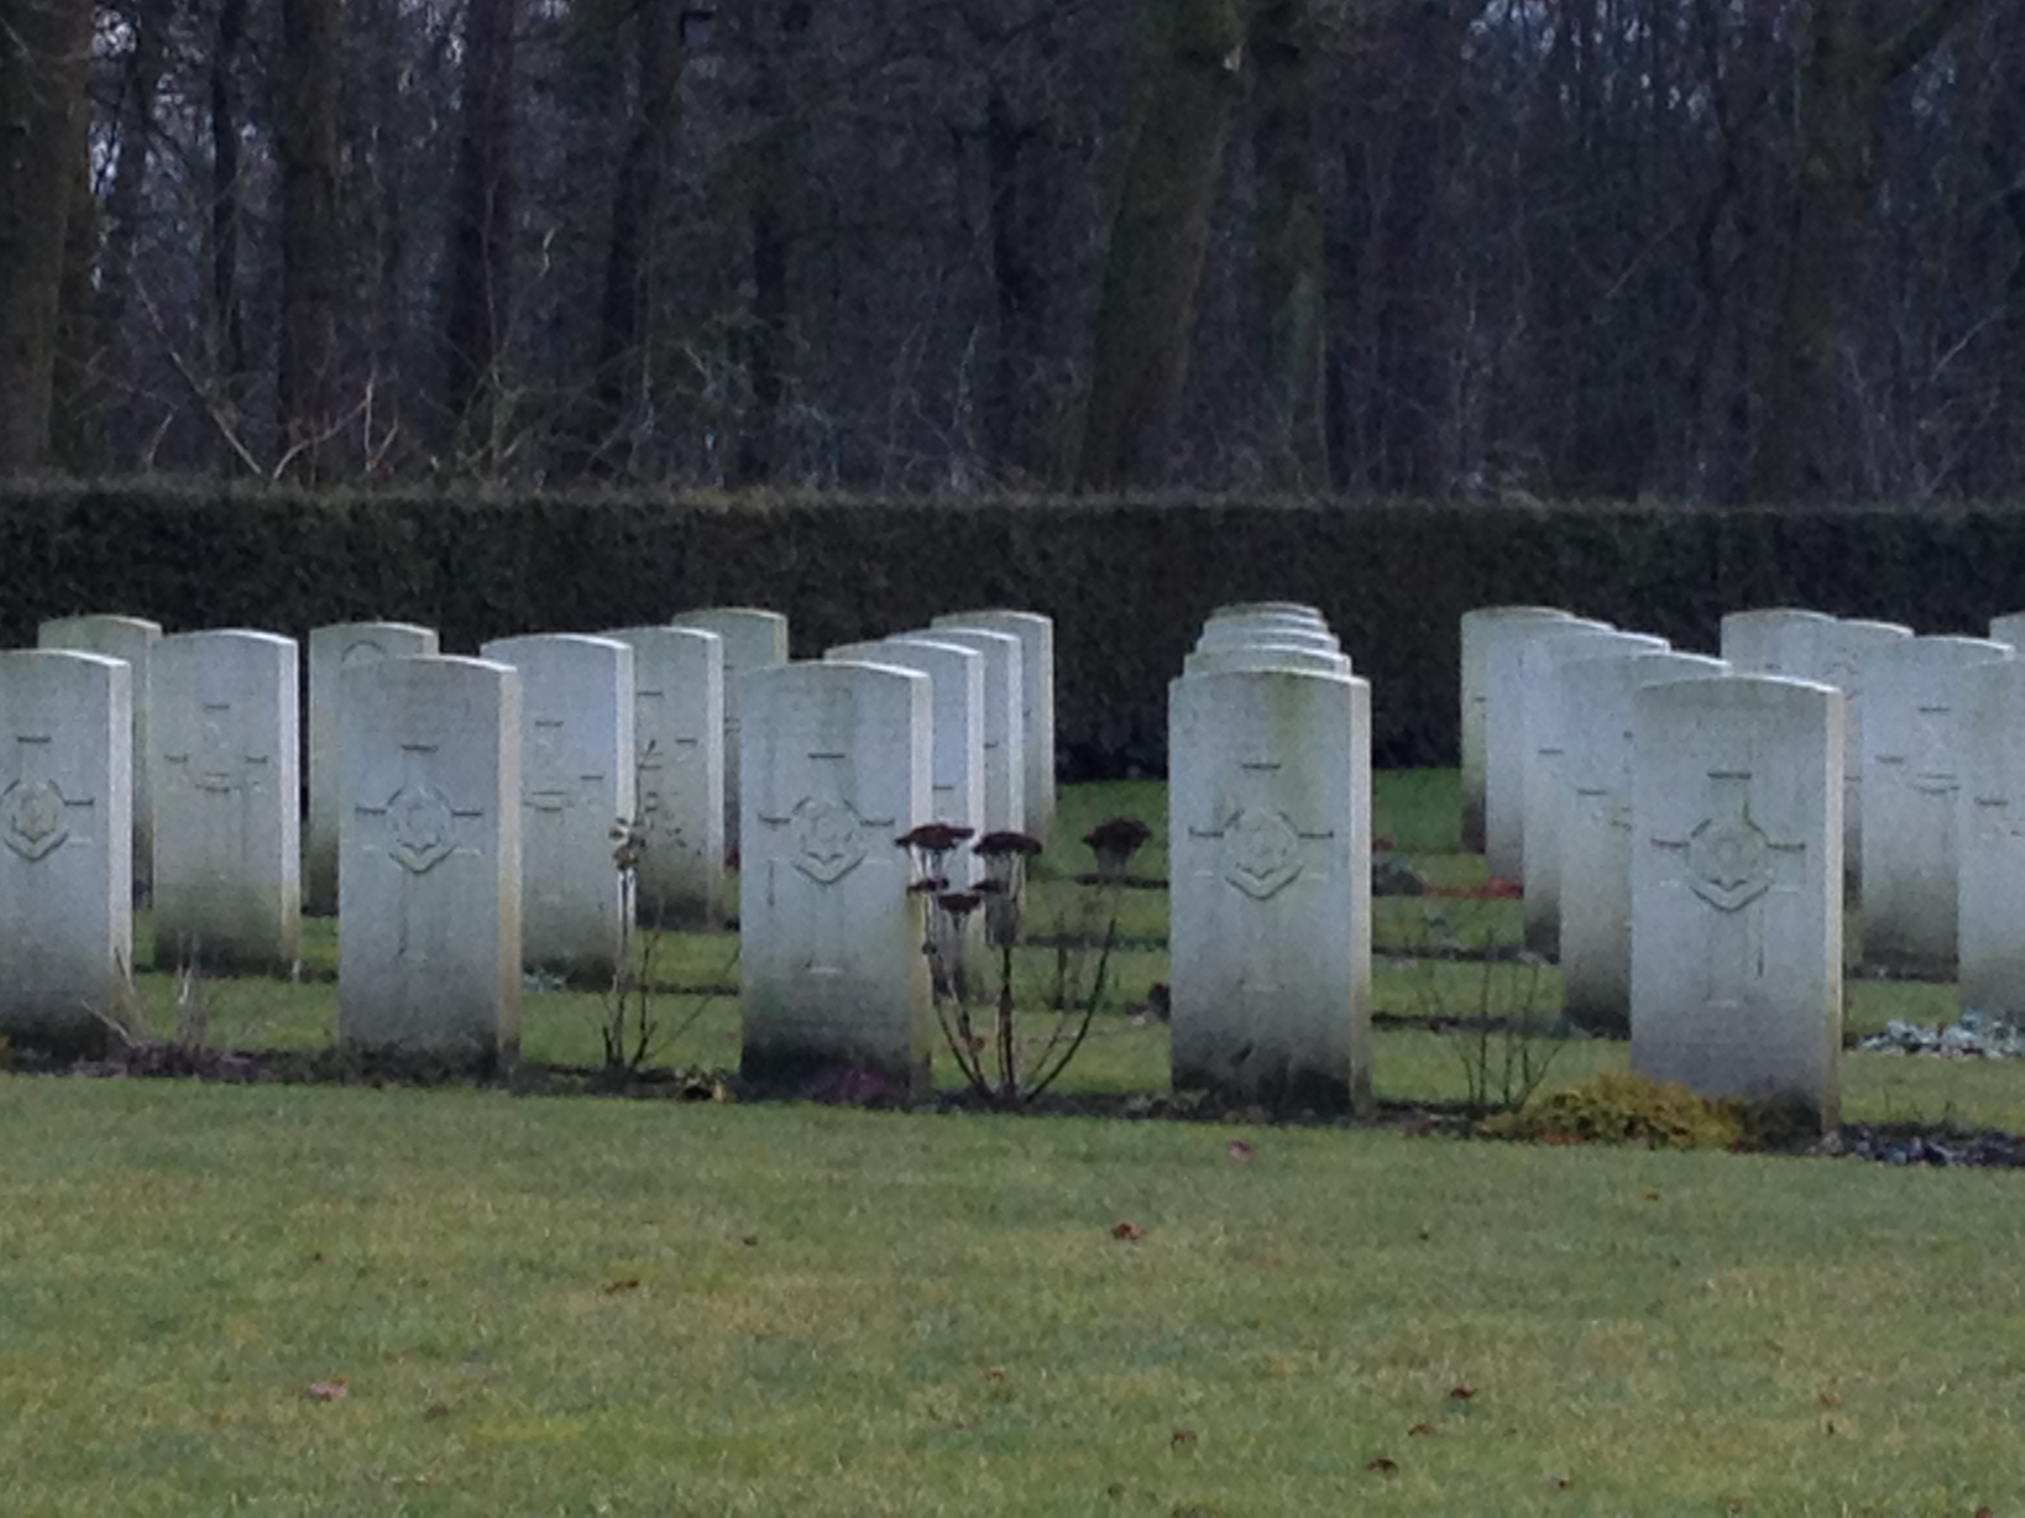

Slide 16
Scenario 3

Slide 17
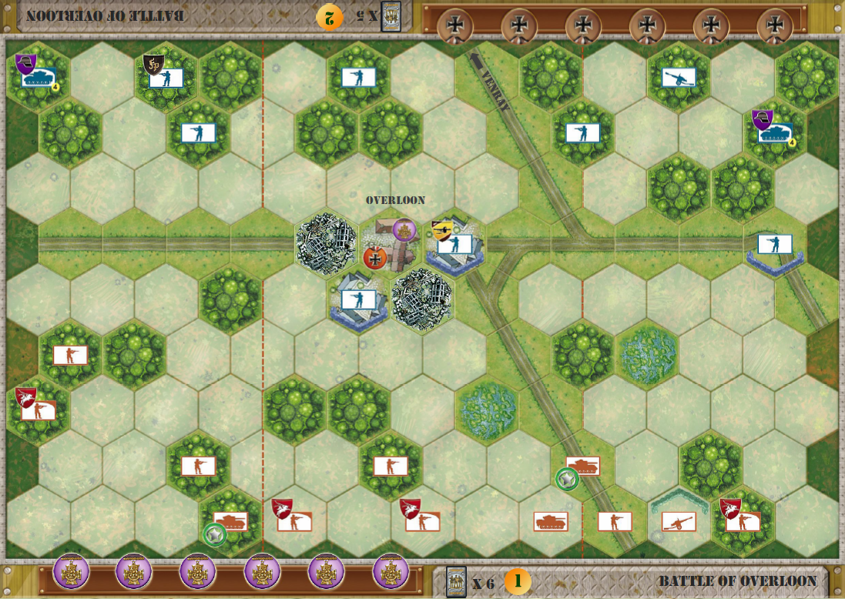
6 Medals
Axis: 5 cards
Allies: 6 cards
Temp majority medal.
Special forces
SWA Anti-tank
Supported armor
Engineers
Church
Marshes
City Ruins

Slide 18
Viel Glück

Slide 19
Scenario 4

Slide 20
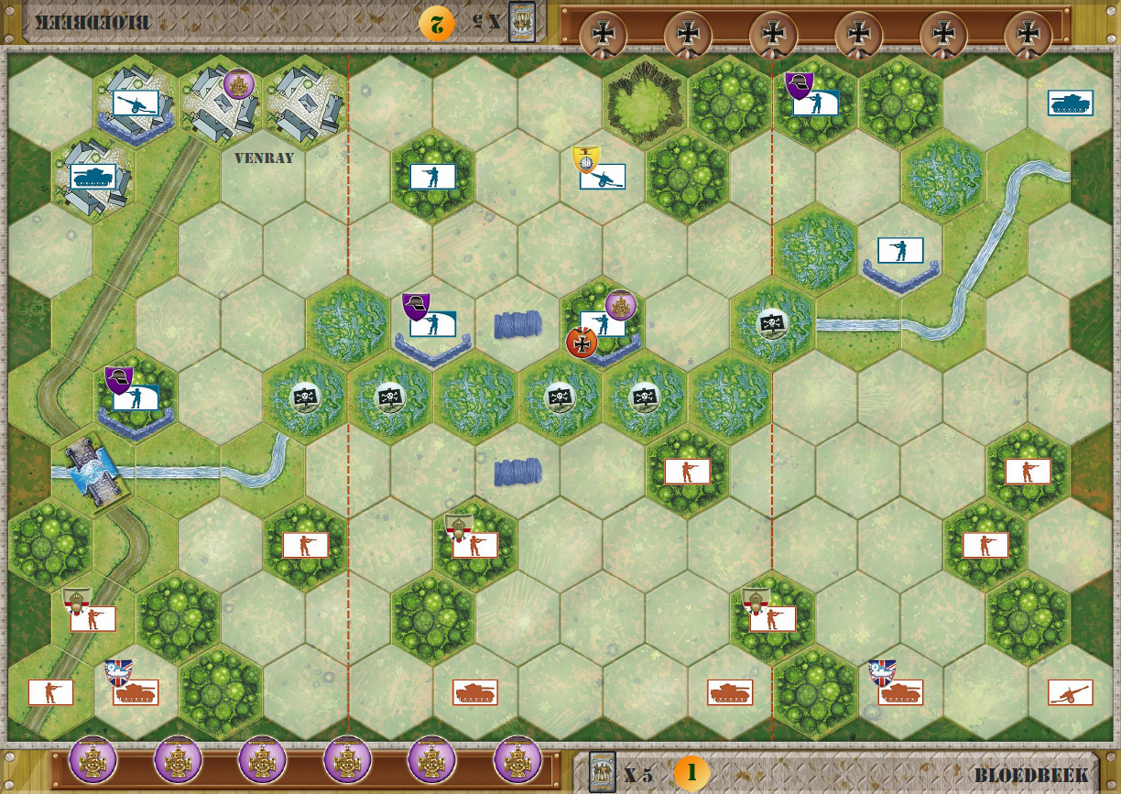
6 Medals
Axis: 5 cards
Allies: 5 cards
Temporary medal
Special forces
88mm
Combat Engineers
Hobarts funnies
Impassible River / broken bridge
Marshes
Mines detonate for both sides

Slide 21
Veel Geluk

Slide 22
Scenario 5

Slide 23
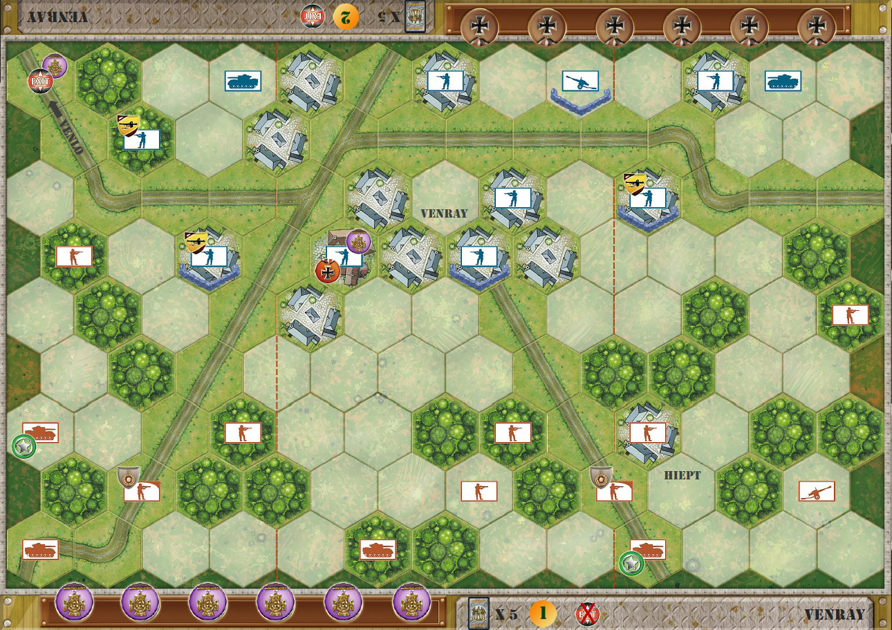
6 Medals
Axis: 5 cards
Allies: 5 cards
Temporary medal
Exit (axis only)
Special forces
SWA Anti-tank
Supported armor
Big Gun / Forward Spotting
Church

Slide 24
Bonne Chance

Slide 25
Goede reis en tot volgend jaar!

